Slide 1
MIDROAD VEHICLE BREAKDOWN ASSISTANCE
Under the guidance of
Dr. E. UMA Assistant Professor (SL.GR) Department of Information Science and Technology(DIST)
BALASANKAR S
2019202005
MCA(REGULAR)

Slide 2
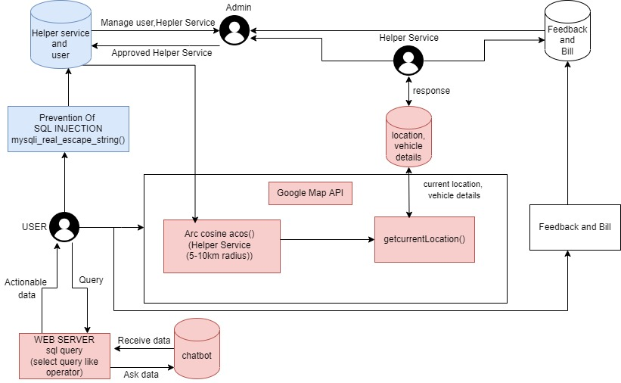
OVERALL ARCHITECTURE

Slide 3
LIST OF MODULES
Register and Login:
The user and the Helper Service should register in this application.
Then user and the Helper service can log in to the application by providing their email and password.
After approved by Admin, Helper service can help and provide service to the user
Update Profile:
Users and the Helper Service can able to view and update their profile.

Slide 4
LIST OF MODULES
Chat Bot:
In the chat bot user send their queries and get back the solution from the bot.
Connect with Helper Service:
User selects needed helper service, the helper service are Mechanic, Towing, Fuel
Nearby helper services are listed then connect with the convenient helper service.

Slide 5
LIST OF MODULES
User chat with Helper Service and vice versa:
The user sends a request.
After accepting by the helper service, the user sends information about the issue and sends the current location using Google Maps API to the helper service.
User Details:
The user’s details are listed to the admin. Admin view all about the user details and manages those details.
Helper Service:
Helper service details are listed to the admin. Admin view all about the helper service details and manages those details.

Slide 6
LIST OF MODULES
Approve Helper Service:
Admin verifies the details provided by the helper service and approves the helper service if the details are valid.
Payment and Feedback:
After the service is finished users pay for the service and give feedback about the service.
Feedbacks are listed to the helper service.
Good feedback motivates the helper service to give service in much good way, Bad feedback helps helper service to improve their services in comparison to previous services
By getting feedback from the users, admin manages helper service by continuing or rejecting the helper service

Slide 7
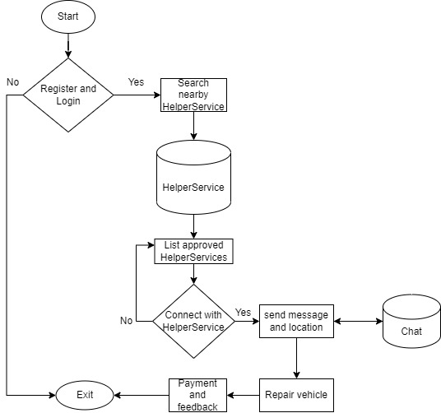
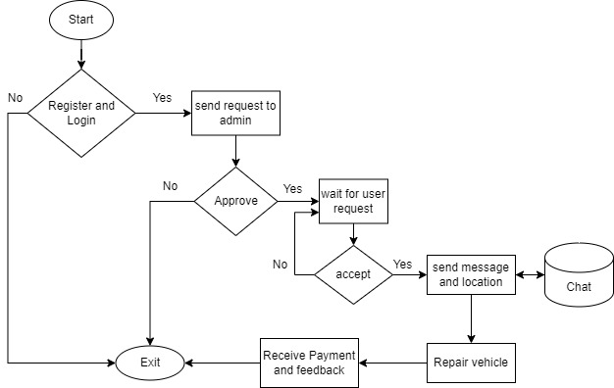
Detailed design of each module with flow chart
USER
HELPER SERVICE

Slide 8
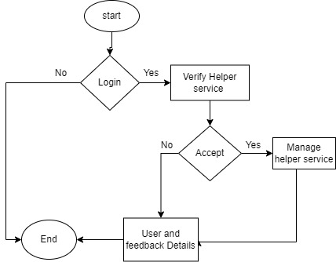
Detailed design of each module with flow chart
Admin

Slide 9
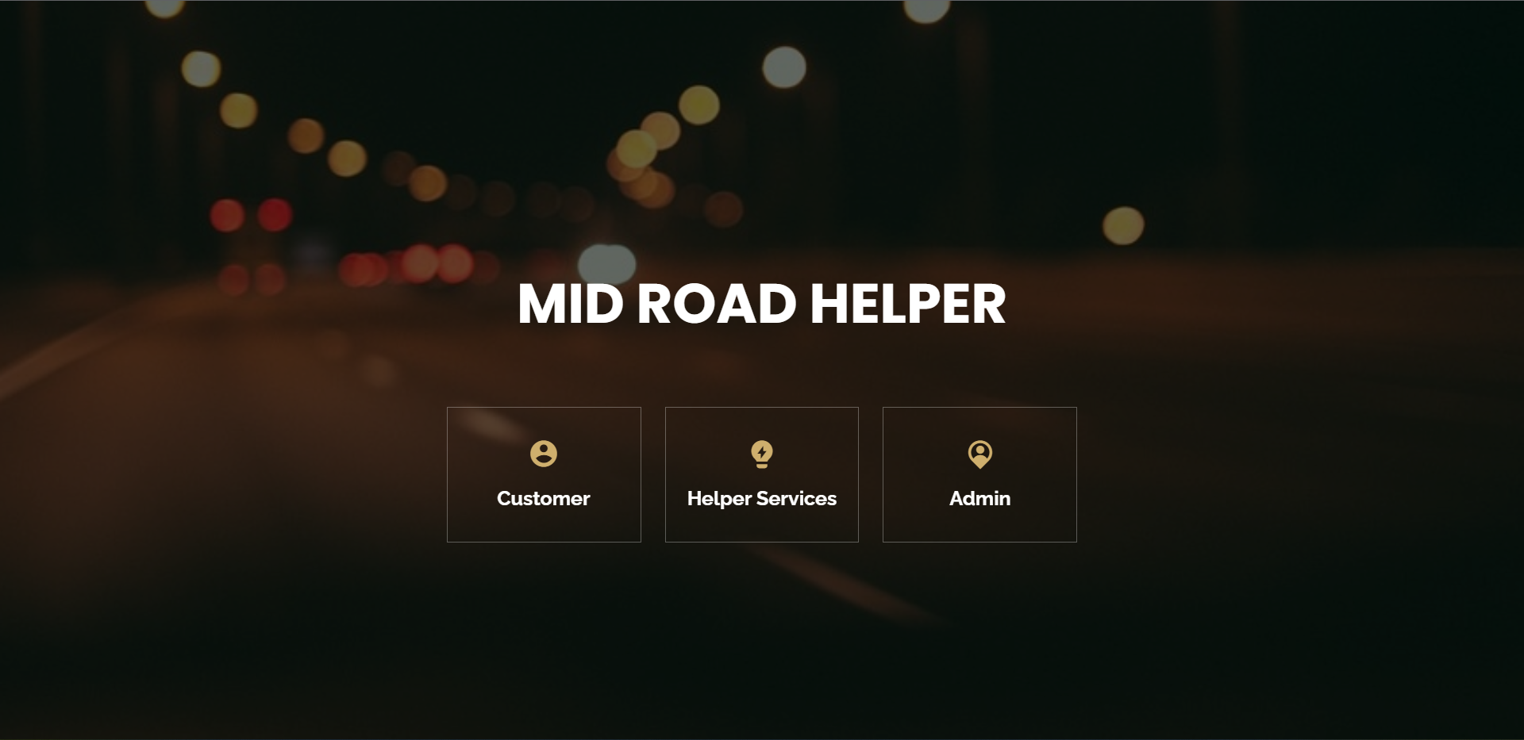
MODULE BASED OUTPUT SCREENSHOTS
Home Page

Slide 10
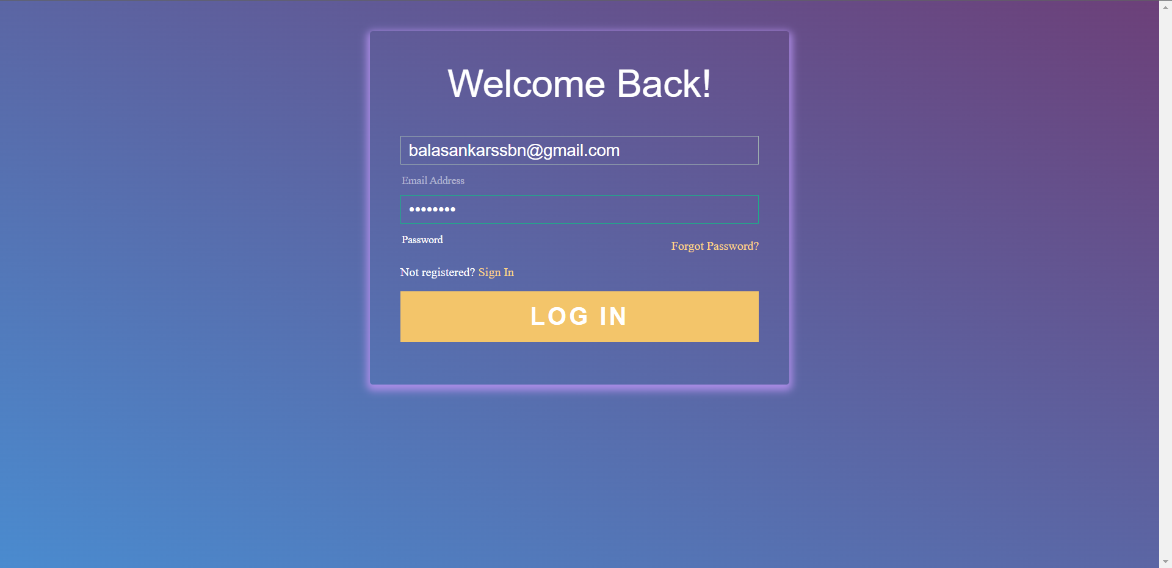
MODULE BASED OUTPUT SCREENSHOTS
Login Page

Slide 11
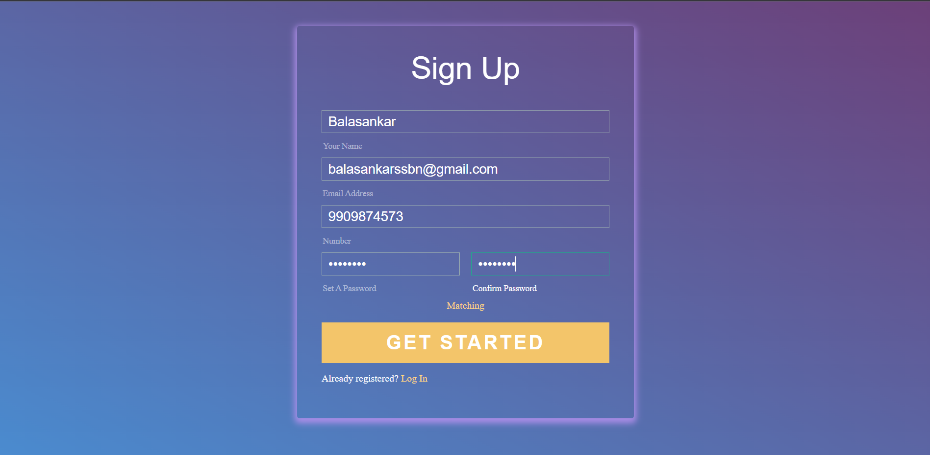
MODULE BASED OUTPUT SCREENSHOTS
User Registration

Slide 12
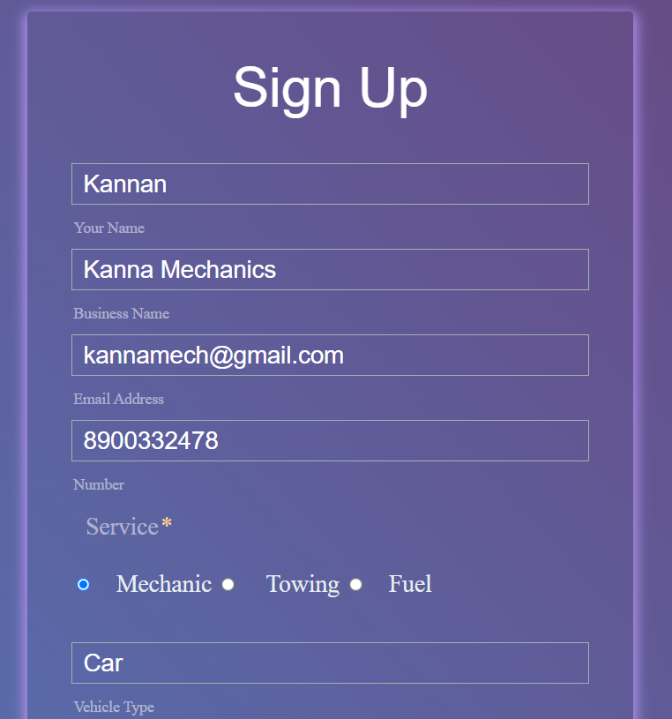
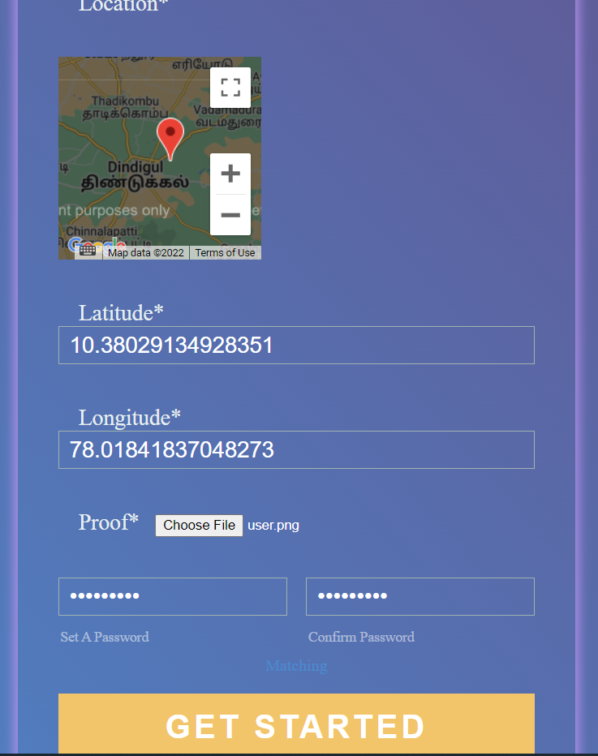
MODULE BASED OUTPUT SCREENSHOTS
Helper Service Registration

Slide 13
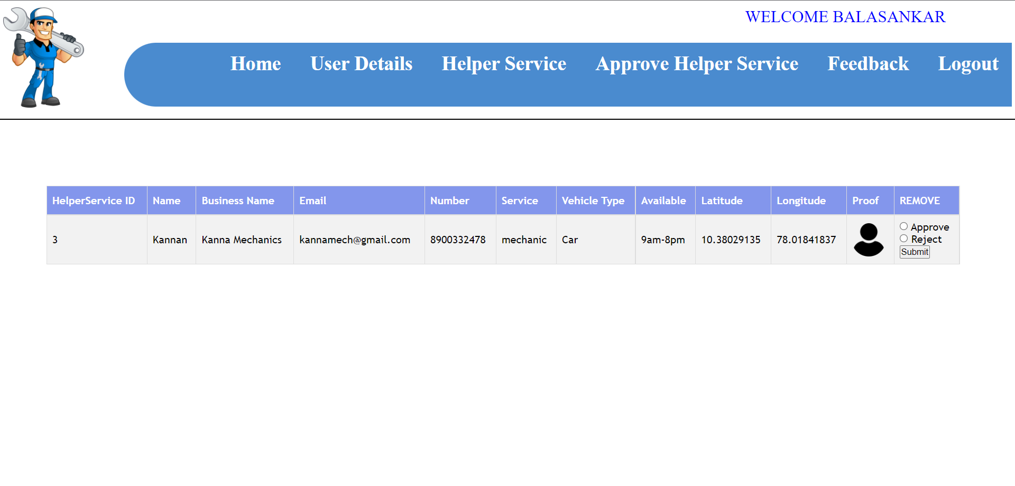
MODULE BASED OUTPUT SCREENSHOTS
Admin Approve Helper Service page

Slide 14
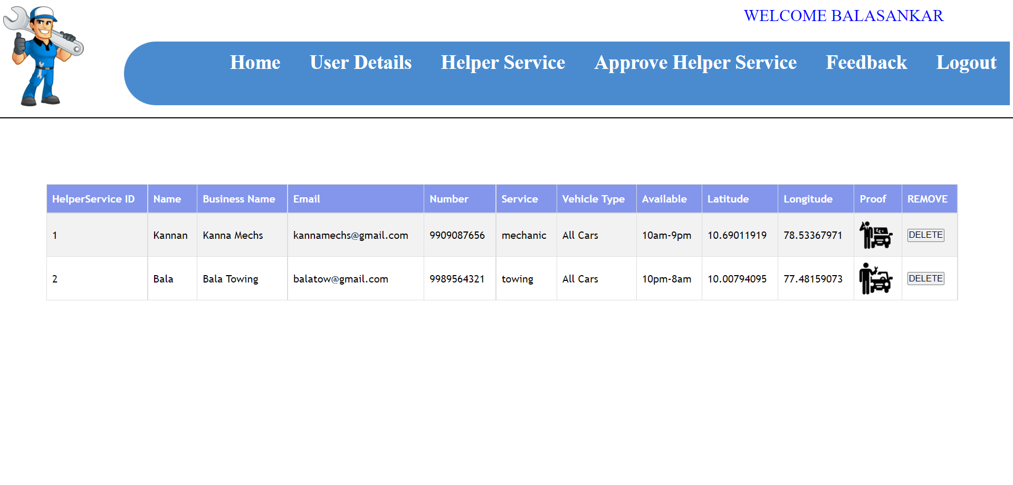
MODULE BASED OUTPUT SCREENSHOTS
Admin Manage Helper Service Page

Slide 15
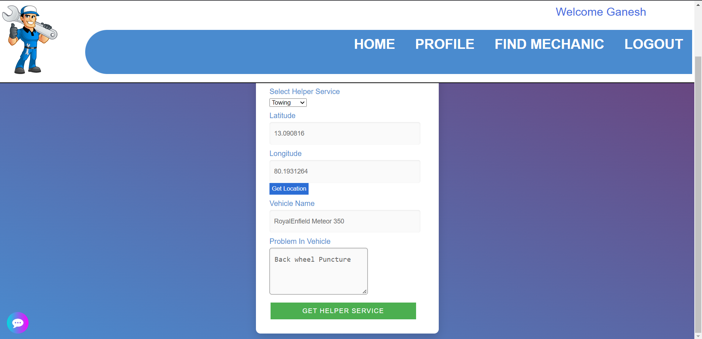
MODULE BASED OUTPUT SCREENSHOTS
Find Helper service

Slide 16
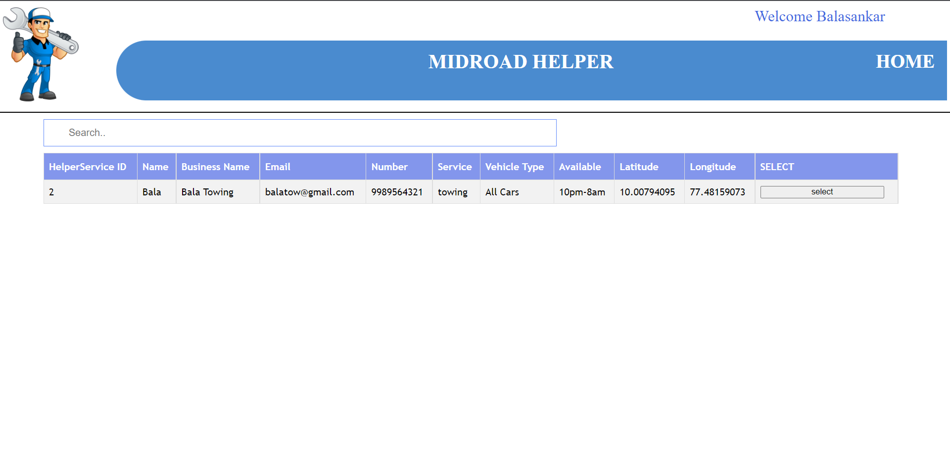
MODULE BASED OUTPUT SCREENSHOTS
Connect with Mechanic

Slide 17
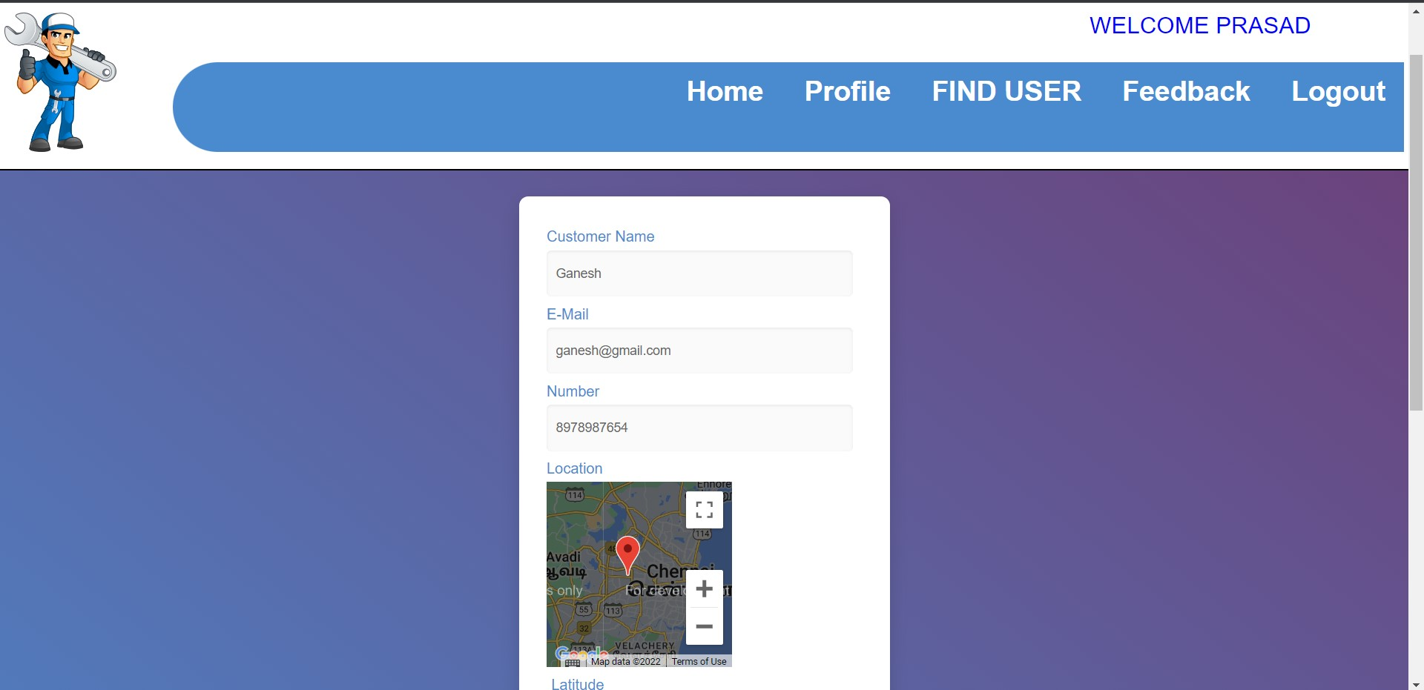
MODULE BASED OUTPUT SCREENSHOTS
Accept User

Slide 18

MODULE BASED OUTPUT SCREENSHOTS
Accept User

Slide 19
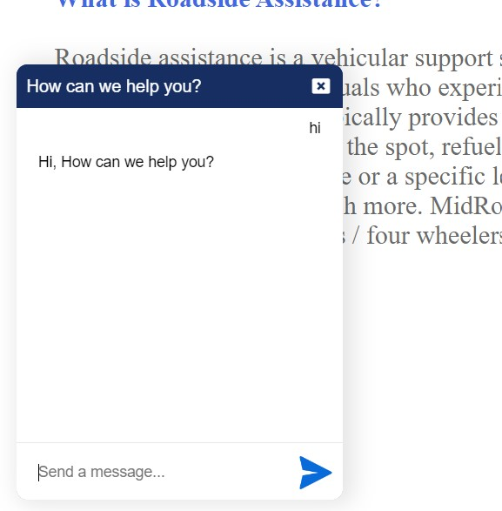
MODULE BASED OUTPUT SCREENSHOTS
Chabot

Slide 20
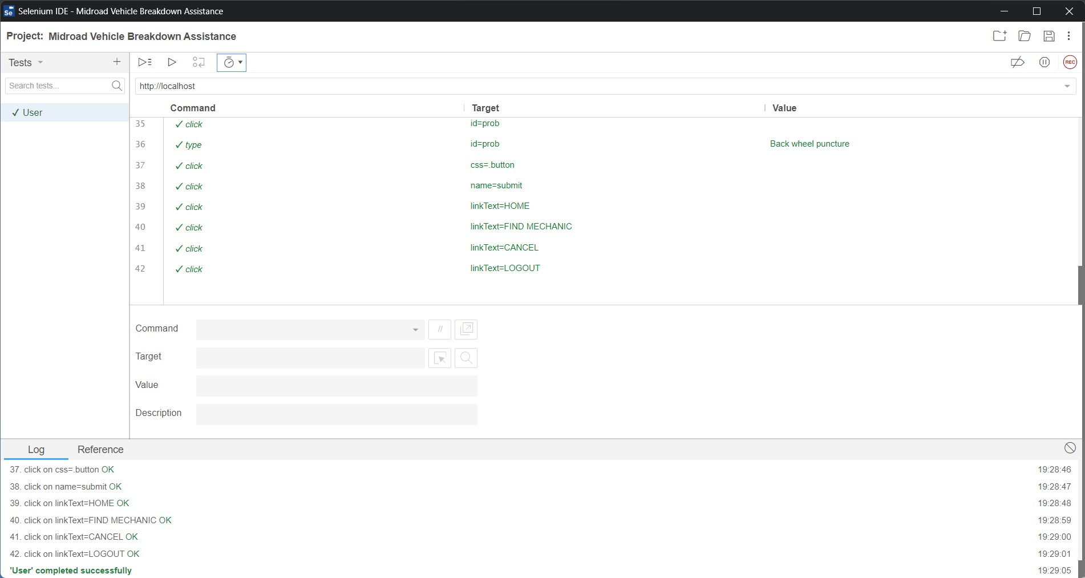
UNIT TESTING WITH TEST CASES FOR EACH MODULE

Slide 21
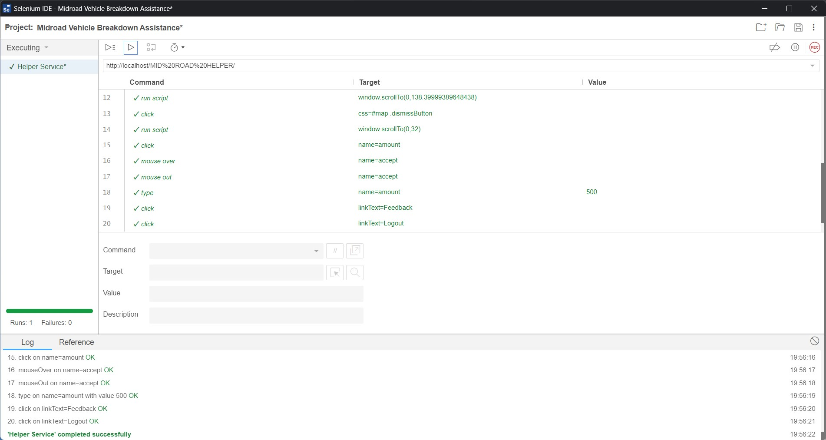
UNIT TESTING WITH TEST CASES FOR EACH MODULE

Slide 22
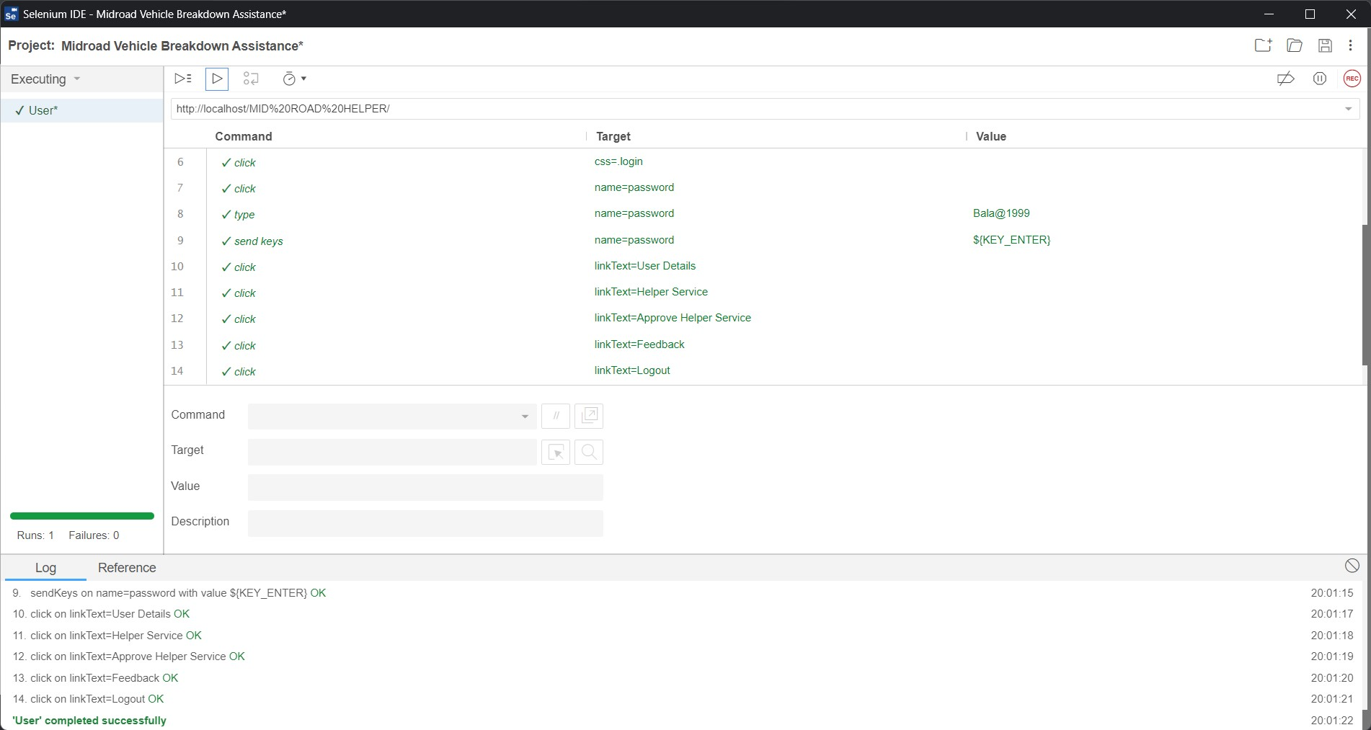
UNIT TESTING WITH TEST CASES FOR EACH MODULE

Slide 23
THANK YOU

